Slide 1
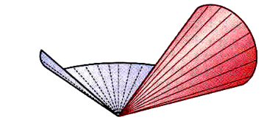
Surface Development
Prepared by:
Er. Bibek Magar
BE in Automobile Engineering
IOE, Thapathali Campus
bibek.magar@thc.tu.edu.np

Slide 2
Surface Development
If the surface of a solid is laid out on a plain surface, the shape thus obtained is called the development of that solid. In other words, the development of a solid is the shape of a plain sheet that by proper folding could be converted into the shape of the concerned solid.
Knowledge of development is very useful in sheet metal work, construction of storage vessels, chemical vessels, boilers, and chimneys. Such vessels are manufactured from plates that are cut according to these developments and then properly bent into desired shapes. The joints are then welded or riveted.
In this chapter, the discussion is limited to the development of cut or uncut simple solids such as prisms, pyramids, cones and cylinders.

Slide 3
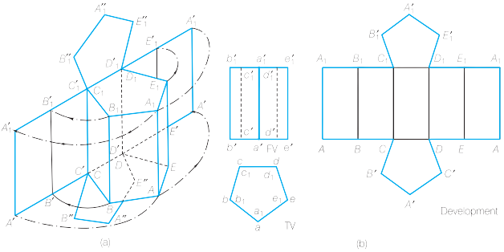
when surfaces are laid out on a plane surface, all of them appear in their true shape and true size.

Slide 4
General Steps to approach the surface development problem:
Copy the question exactly without altering the given information.
Complete the effects of sectioning of the solid in it’s respective views (most commonly top view).
Determine the true shape of the section which appears as an apparent shape.
Develop the Lateral surface of the uncut solid.
Determine the critical points in the uncut lateral surface to add the effects of sectioning of the solid.
Attach the true top surface and bottom surface to the finally developed lateral surface of the solid.

Slide 5
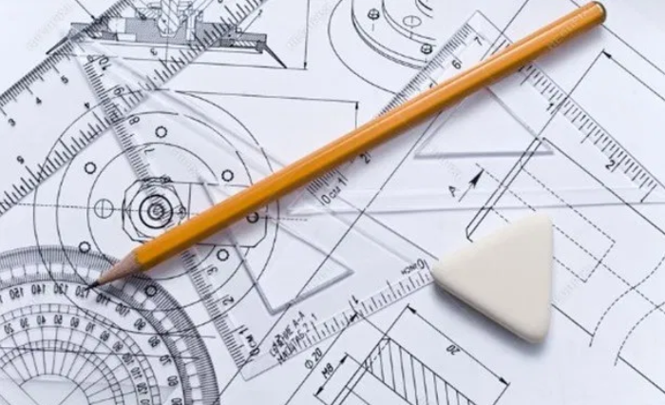
Solved Examples:

Slide 6
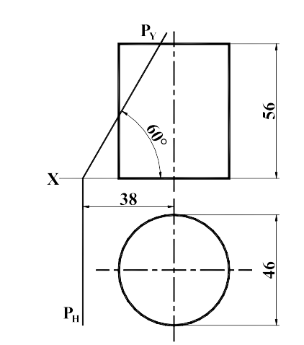
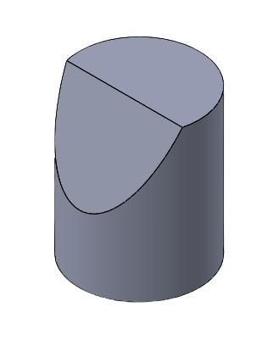
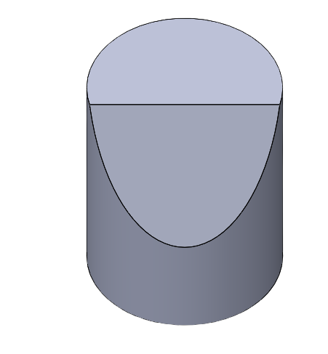
1) Make a complete orthographic drawing of a geometrical solid cut by a plane. Find the true shape of the section. Construct the development of the surface of the solid.
3D Visualization:

Slide 7
56.0000
120°
Ø46.0000
38.0000

Slide 8
56.0000
120°
Ø46.0000
38.0000

Slide 9
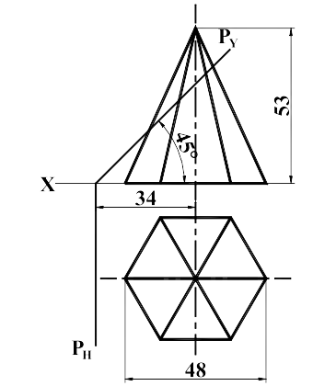
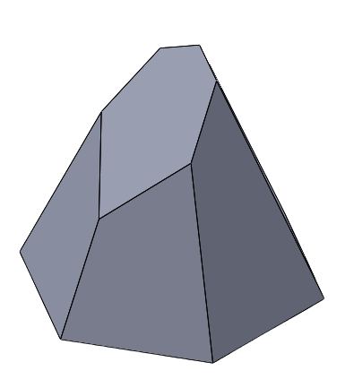
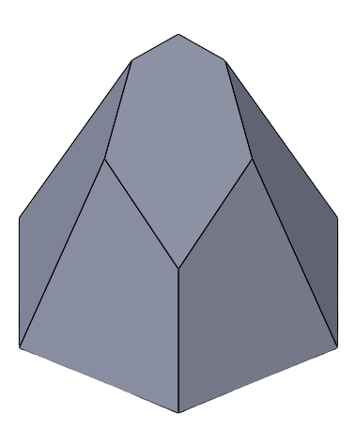
2) Make a complete orthographic drawing of a geometrical solid cut by a plane. Find the true shape of the section. Construct the development of the surface of the solid.
3D Visualization:

Slide 10
53.0000
45°
34.0000

Slide 11
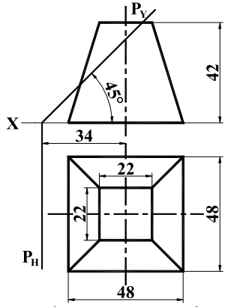
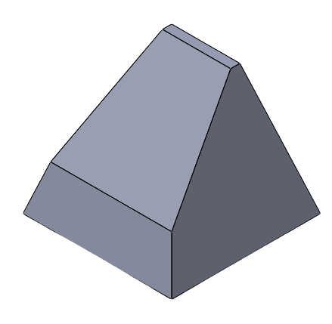
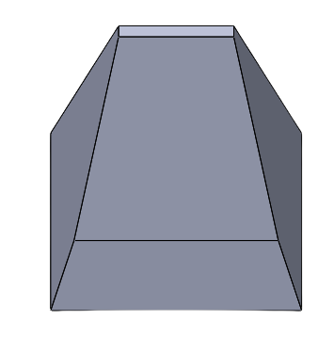
3) Make a complete orthographic drawing of a geometrical solid cut by a plane. Find the true shape of the section. Construct the development of the surface of the solid.
3D Visualization:

Slide 12
c'
d'
d1'
d1
c
d
c'd1' = TL

Slide 14
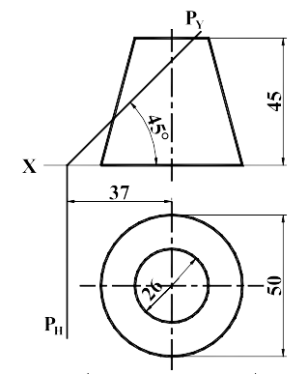
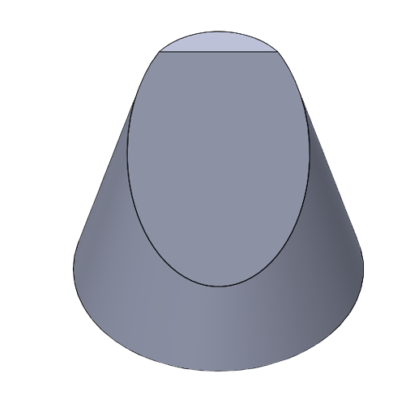
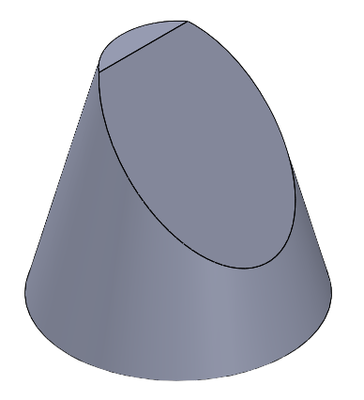
4) Make a complete orthographic drawing of a geometrical solid cut by a plane. Find the true shape of the section. Construct the development of the surface of the solid.
3D Visualization:

Slide 16
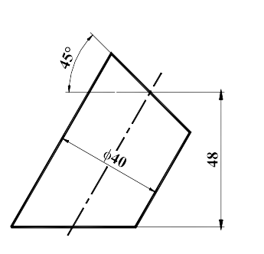
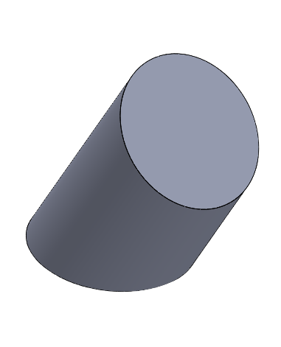
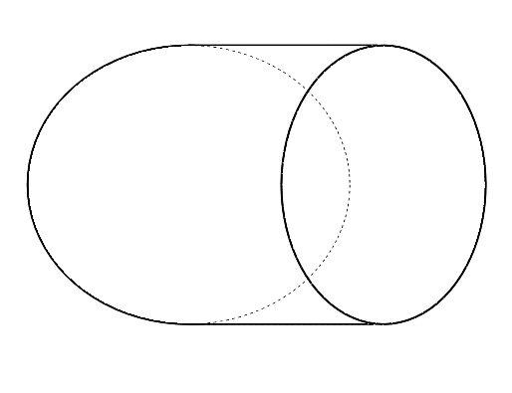
5) Develop the lateral surface of a cylindrical piece shown in Figure below:
3D Visualization:
60°

Slide 18
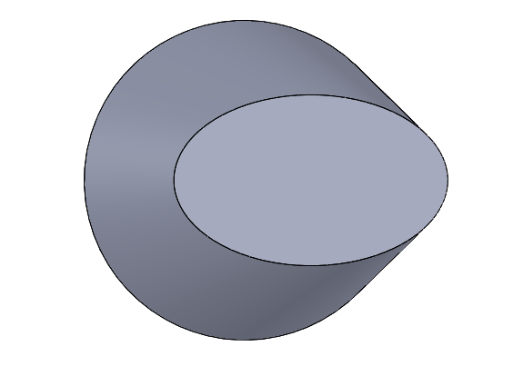
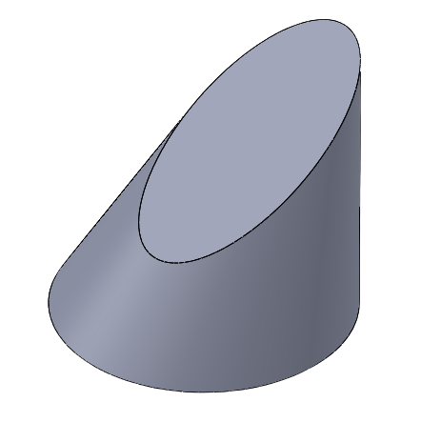
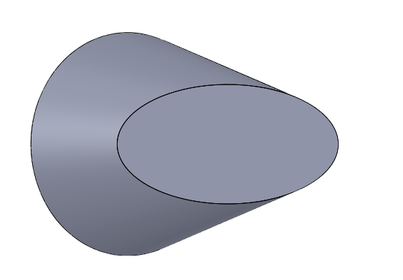
6) Make a complete orthographic drawing of a geometrical solid cut by a plane. Find the true shape of the section. Construct the development of the surface of the solid.
3D Visualization:
60
60°
30°
30
Ø42

Slide 21
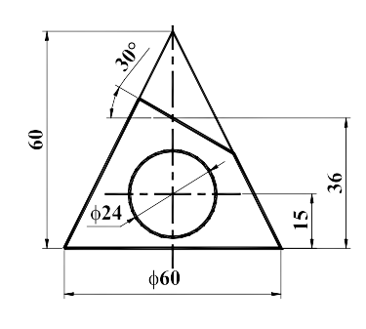
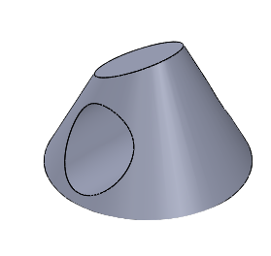
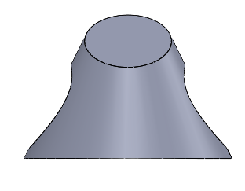
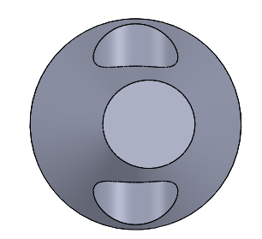
7) A right circular cone is cut as shown in the figure below. Develop its lateral surface.
3D Visualization:

Slide 23
Thank You

